Slide 1
Multi Dimensional Arrays

Slide 2
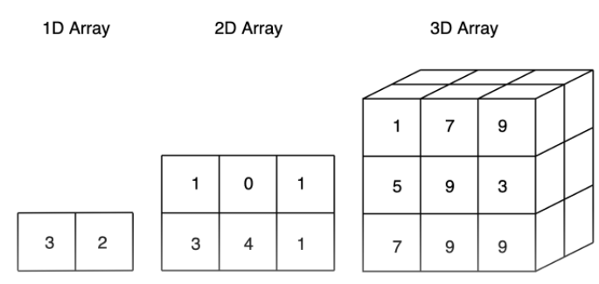

Slide 3
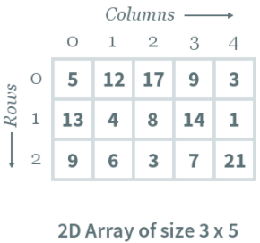
Multi-dimensional array
A multi-dimensional array is an array of arrays. 2-dimensional arrays are the most commonly used. They are used to store data in a tabular manner.
Consider following 2D array, which is of the size 3×5. For an array of size N×M, the rows and columns are numbered from 0 to N−1 and columns are numbered from 0 to M−1, respectively. Any element of the array can be accessed by arr[i][j] where 0≤i<N and 0≤j<M. For example, in the following array, the value stored at arr[1][3] is 14.

Slide 4
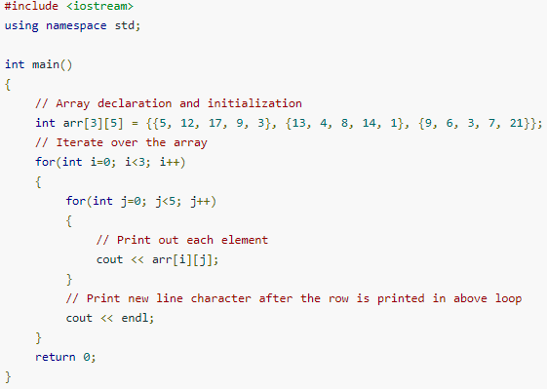
Declaration and Initialization
To declare a 2D array, you must specify the following: Row-size: Defines the number of rows Column-size: Defines the number of columns
type arr[row_size][column_size];
int array[3][5];
An array can either be initialized during or after declaration. The format of initializing an array during declaration is as follows:
type arr[row_size][column_size]={{element1},{element2}…};
int array[3][5]={{5,12,17,9,3}, {13,4,8,14,1},{9,6,3,7,21}};

Slide 5
The size of a two dimensional array is equal to the multiplication of number of rows and the number of columns present in the array. We do need to map two dimensional array to the one dimensional array in order to store them in the memory.
There are two main techniques of storing 2D array elements into memory:
Row major
Column Major

Slide 6
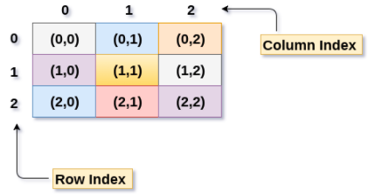
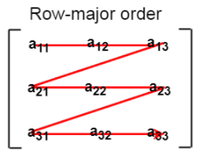
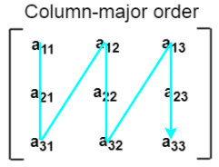

Slide 7
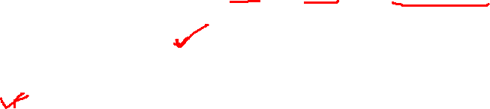
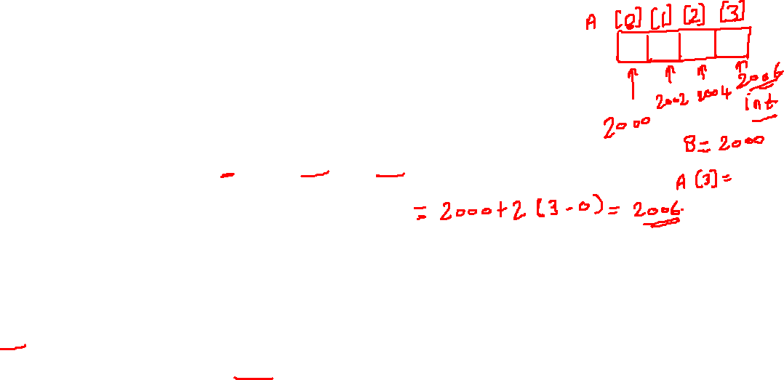
Calculating the Address of the random element of a 1D array
Array of an element of an array say “A[ I ]” is calculated using the following formula: Address of A [ I ] = B + W * ( I – LB ) Where, B = Base address W = Storage Size of one element stored in the array (in byte) I = Subscript of element whose address is to be found LB = Lower limit / Lower Bound of subscript, if not specified assume 0 (zero)

Slide 8
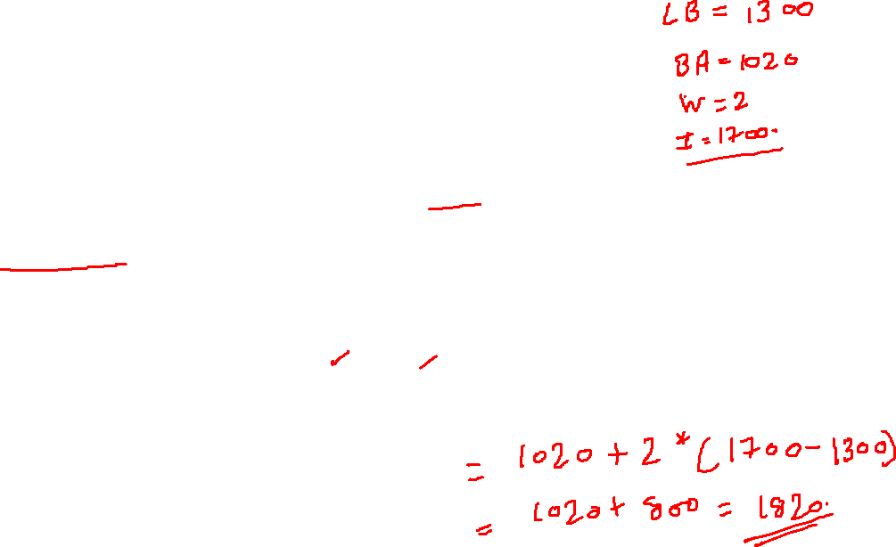
Given the base address of an array B[1300…..1900] as 1020 and size of each element is 2 bytes in the memory. Find the address of B[1700]. Solution: The given values are: B = 1020, LB = 1300, W = 2, I = 1700 Address of A [ I ] = B + W * ( I – LB ) = 1020 + 2 * (1700 – 1300) = 1020 + 2 * 400 = 1020 + 800 = 1820

Slide 9
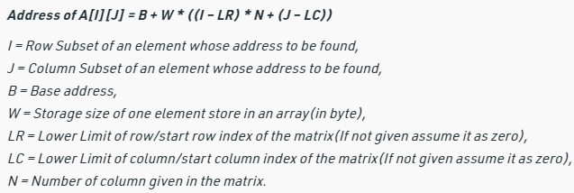
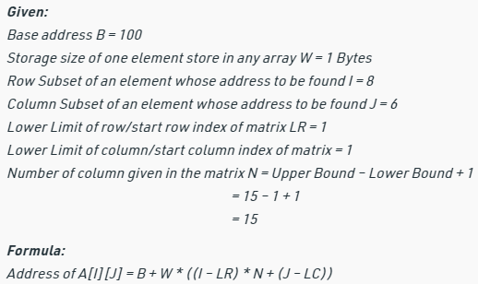
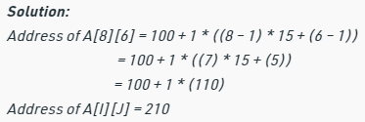
Address of element in row major order
Given an array, arr[1………10][1………15] with base value 100 and the size of each element is 1 Byte in memory. Find the address of arr[8][6] with the help of row-major order?

Slide 10
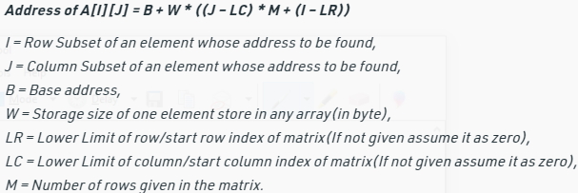
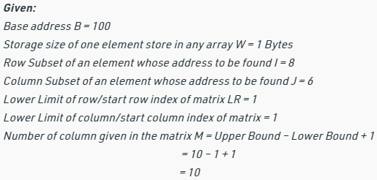
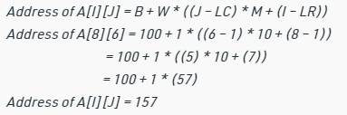
Address of element in column major order
Given an array arr[1………10][1………15] with base value 100 and the size of each element is 1 Byte in memory find the address of arr[8][6] with the help of column-major order.

Slide 11
A[10…30, 55…75], Base address = 0, Size of element = 4 bytes, Find the location of A[15][68] by row major order.
A[-5…20, 20…70], Base address = 1020, Size of element = 8 bytes, Find the location of A[0][30] by column major order.

Slide 12
In three - dimensional array also address is calculated through two methods i.e; row-major order and column-major method. To calculate address of element X[ i,j,k] using row-major order : Location ( X[i,j,k] )=BA + MN (k-1) + N (i-1) + (j-1) To calculate address of element X[ i,j,k] using column-major order Location ( X[i,j,k] )=BA + MN (k-1) + M (j-1) + (i-1) For example : Given an array [ 1..8, 1..5, 1..7 ] of integers. Calculate address of element A[5,3,6], by using rows and columns methods, if BA=900? Solution:- The dimensions of A are : M=8 , N=5, R=7, i=5, j=3, k=6 Rows - wise : Location (A[i,j,k]) = BA + MN(k-1) + N(i-1) + (j-1) Location(A[5,3,6])= 900 + 8x5(6-1) + 5(5-1) + (3-1) = 900 + 40 x 5 +5 x 4 + 2 = 900 + 200 +20 +2 = 1122 Columns - wise : Location (A[i,j,k]) = BA + MN(k-1) + M(j-1) + (i-1) Location (A[5,3,6]) = 900 + 8x5(6-1) + 8(3-1) + (5-1) = 900 + 40 x 5 +8 x 2 + 4 = 900 + 200 +16 +4 = 1120

